Slide 1
Business Process Engineering
Business Process Management
Lecture: 04
Instructor: Salman Ahmad

Slide 2
Process Identification
What?
Identify an organization’s business process
Prioritize their management based on certain criteria
Why?
Under stand organization
Maximize value of BOM projects

Slide 3
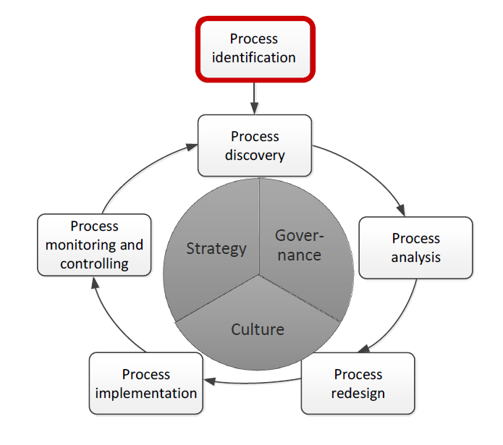

Slide 4
Processes Identification Steps
Process Architecture
Enumerate main process
Determine process scope
Process Prioritization
Importance
Health
Feasibility
Notes:
Please explain?
Discuss the example of the Titanic and why the rafts were never thought of something else?

Slide 5
Process Enumeration
“Most businesses have just three core processes”
Sell stuff
Deliver stuff
Making sure they have stuff to sell and deliver”
Geary Rummler

Slide 6
Types of processes
Management Processes
Core Processes
Suppliers / Partners
Customers / Stakeholders
Support Processes
Notes:
Fortress framework

Slide 7
Example: Grocery Wholesalers
Core Processes
Sales (lead-to-quote, quote-to-order, order-to-cash)
Purchase to Pay (direct procurement)
…
Support Process
Purchase to Pay (indirect procurement)
HR (policies, recruitment, induction, etc)
…
Management Process
Supplier Management
Logistic Management
…

Slide 8
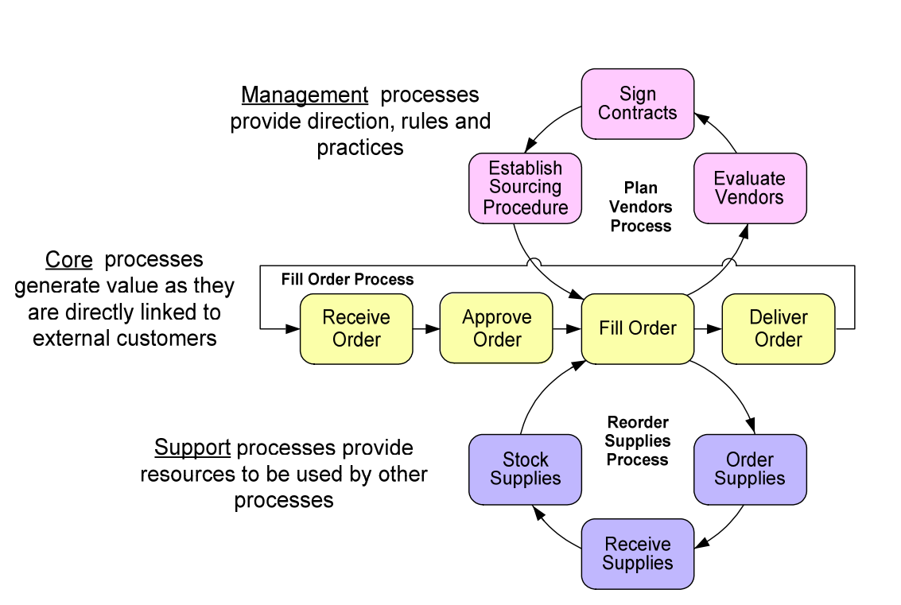
Relationship between processes

Slide 9
Example: Wholesaler
IT
Direct Procurement
Demand Management
Indirect Procurement
Marketing
Service
Supplier Management
Distribution
Logistics Management
Warehouse Management
Strategic Management
HR
Finance
Sales
Notes:
Solan applied division on labor on organization where as Ford applied it on manufacturing

Slide 10
Example: Wholesaler
Demand Management
Strategic Management
Supplier Management
Logistics Management
Warehouse Management
Sales
Direct Procurement
Marketing
Distribution
Service
HR
Finance
IT
Indirect Procurement

Slide 11
Example: Insurance company
Strategic Management
Corporate Development
Market Development
Investor Relations
Risk Assessment & Management
Marketing & Sales
Underwriting Management
Policy Servicing
Claims Management
Payments Collection & Disbursement
Assets Management
Legal
Finance
IT
HR
Reinsurance

Slide 12
Process Scoping
Processes are independent -> insights into interrelations required
Specialization: general – special product/service
Horizontal: upstream – downstream processes and their value chain
Vertical: main process – sub processes

Slide 13
Value chain modeling
Chain of processes an organization performs to deliver value to customers and stakeholders
A mechanism to group high level business processes according to an order relation
Supplies purchase
Lead to Quote
Quote to Order
Order to Cash
After sale care

Slide 14
Guidelines to Identify Horizontal Boundaries in value chain
Change of Key business object in the process
Change of graduality of main business object
Change in frequency/time
Change in intermediate outcome/resolution/objective

Slide 15
Example: Wholesaler (Core Processes)
Supplies Purchase
Lead to Cash
After sale
Supplies Purchase
Lead to Quote
Quote to Order
Order to Cash
After sale
Supplies Purchase
Storage
Sales
Distribution
After sale

Slide 16
Typical Value Chain for Core Processes
Imagine
Build
Sell
Example: Producer
Source
Make
Deliver
Service
Notes:
Uber example
Product idea, development and bring to market

Slide 17
Typical Value Chain for Core Processes
Source
Make
Deliver
Service
Stocked Product
Make to stock
Deliver stockaded products
Service stocked products
Stocked Products
Source MTO Products
Make to order
Deliver MTO Products
Service MTP Products
MTO Products
Source ETO Product
Engineer to Order
Deliver ETO Products
Service ETO Products
ETO Products

Slide 18
Example value chain for Services
IT service provider
Design
Market
Sales
Deliver
Service
System Integration
Outsourcing
Network Services
Enterprise Server Technology

Slide 19
Typical Value Chain for non core Processes
Support Processes
Recruitment
Induction
Performance Review
Probation
HR
Payroll
Book Keeping
Reporting & Analysis
Auditing
Accounting
Management Processes
Risk Identification
Risk Analysis
Risk Evaluation
Risk Treatment
Risk Management
Suppliers Evaluation
Contract Signing
Sourcing
Supplier Management

Slide 20
Example: Process Architecture & Value Chains
Demand Management
Strategic Management
Supplier Management
Logistics Management
Warehouse Management
Sales
Direct Procurement
Marketing
Distribution
Service
HR
Finance
IT
Indirect Procurement

Slide 21
Example: Process Architecture & Value Chains
Demand Management
Strategic Management
Supplier Management
Logistics Management
Warehouse Management
Value chain
Procure to Service
BOX: Group processes/ value chains
HR
Finance
IT
Indirect Procurement

Slide 22
Example: Process Architecture & Value Chains
QUIZ-01
Management Processes
Sport Services
Marketing
Indirect Recruitment
IP Management
Teaching award courses
Core Processes
Course Management
Strategic Management
Additional Services Management
Course Management
Language Training
IT
Market Management
Teaching Professional Courses
Support Processes
Admission

Slide 23
Example: Process Architecture & Value Chains
QUIZ-01
Management Processes
Market Management
Additional Services Management
Strategic Management
Course Management
IP Management
Core Processes
Marketing
Teaching Professional Courses
Admission
Sport Services
Language Training
Teaching award courses
Support Processes
Indirect Recruitment
IT
Course Management

Slide 24
Quiz

